Slide 1

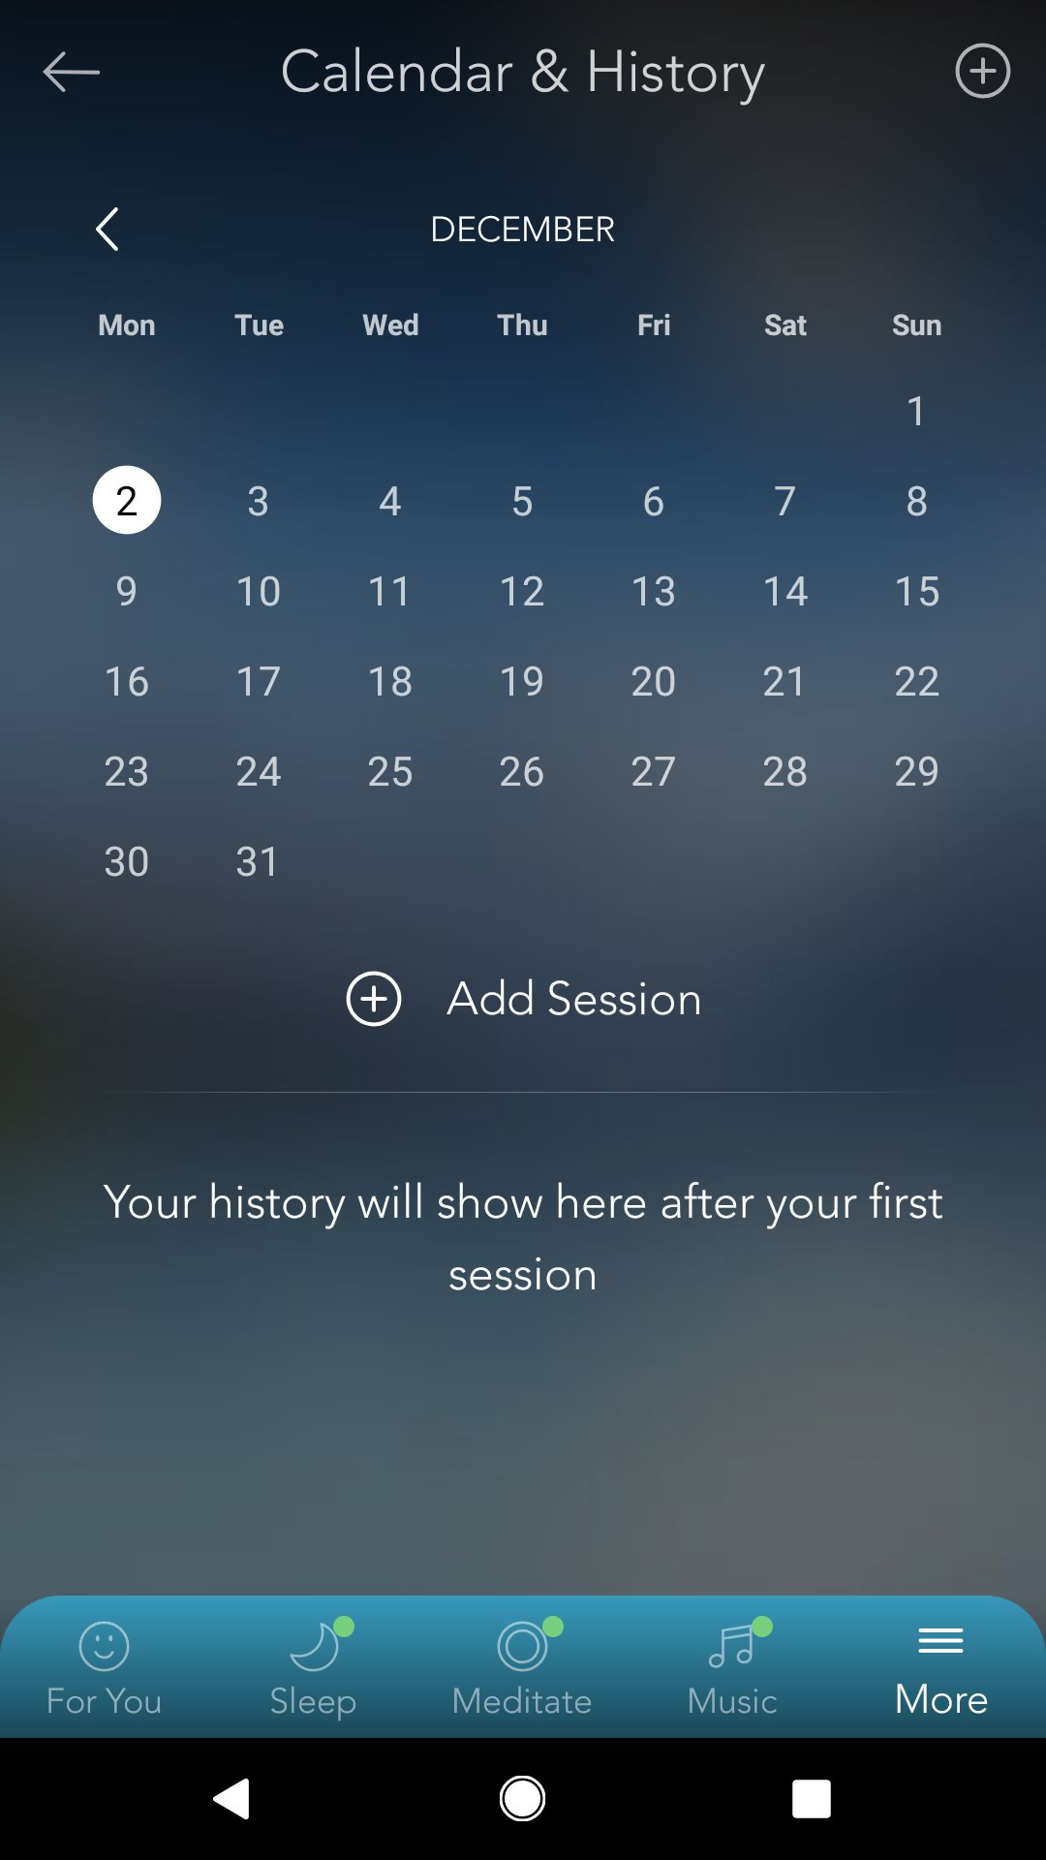
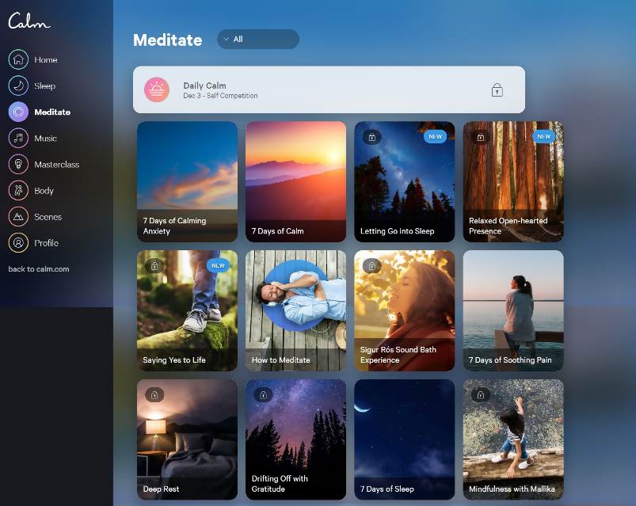
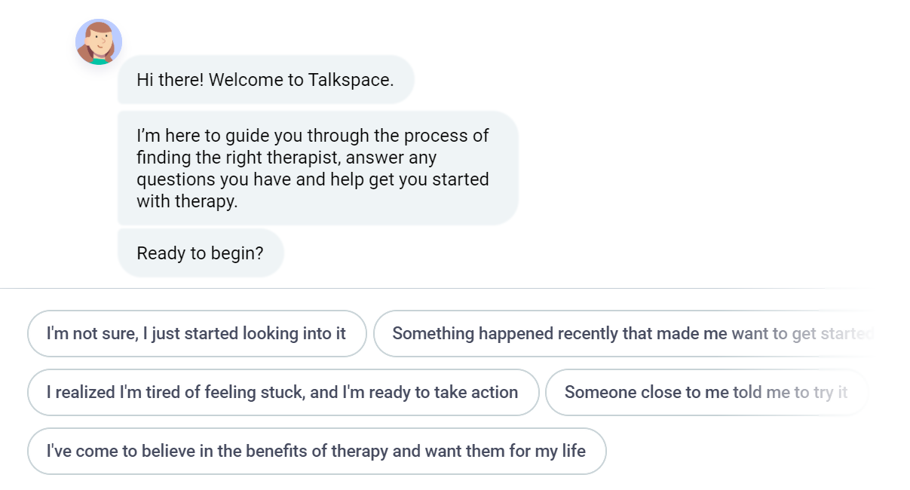
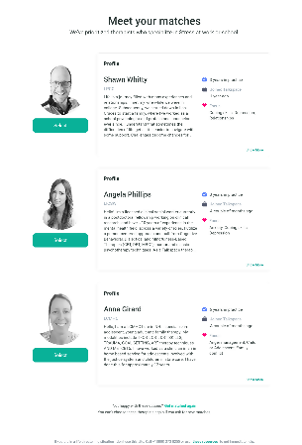
Menu
Homepage
How it work
Business
Contact us
Account
How it work
Business
Contact us
Login
Profile
User Profile
Sign up-Popup
Banner
Assessment Result
Get started
Doctor’s Recommendation
Calendar & Activities
Account
- Log in
- Sign Up
Check-up your mind
Healing by yourself
Meet Psychiatrist
After counseling with your Psychiatrist and Psychologist list
We need:
1. User Profile
2. Report
3. Assessment Result
4. Calendar & Activities (History)
History
Match for your Psychiatrist (Counseling)
- Psychiatrist and Psychologist list
Meditation, Yoga, sound, sleep, exercise (vdo)
3 vdo FREE
More than PREMIUM
Assessment by yourself (Chat bot)
https://app.www.calm.com/meditate

